Slide 1

Data Mining-Project Peer-to-Peer Lending
Bibin Jose
Jaideep Sai
Arshad Jamal
Kireet Bharadwaj

Slide 2
Contents:
Introduction
Data Overview
Data Visualization using Tableau
Objective
Data Cleaning & Pre-Processing
Data Modeling and Inference
Improvements
Future Enhancements
References

Slide 3
Peer-to-Peer Lending
Introduction
Dataset Overview
Objective
Data Cleaning
Data Modeling
Conclusion
Peer-to-peer lending is the practice of lending money to individuals or businesses through online services that match lenders with borrowers.
“Lending Club” is the world's largest peer-to-peer lending platform.
The interest rates can be set by lenders who compete for the lowest rate on the reverse auction model or fixed by the intermediary company on the basis of an analysis of the borrower's credit.
There is the risk of the borrower defaulting on the loans taken out from peer-lending websites.

Slide 4
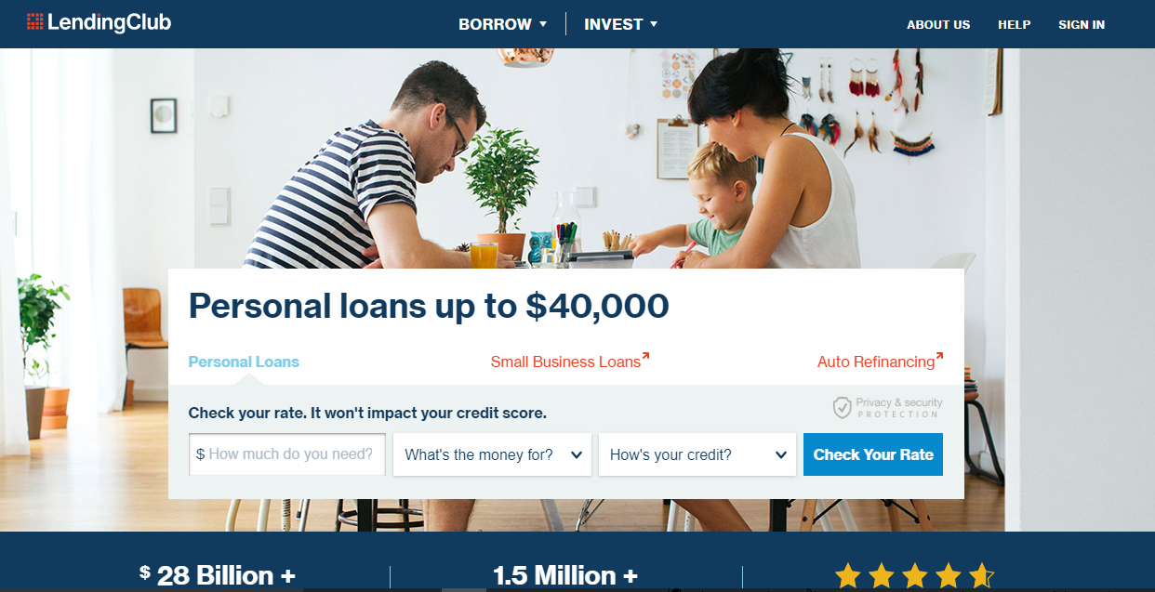
Lending Club
Introduction
Dataset Overview
Objective
Data Cleaning
Data Modeling
Conclusion

Slide 5
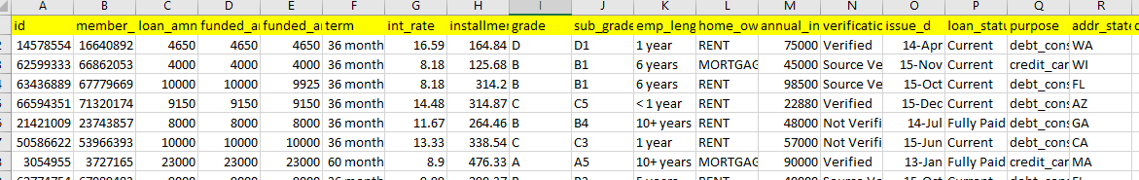
Dataset Overview
Introduction
Dataset Overview
Objective
Data Cleaning
Data Modeling
Conclusion
Dataset was acquired from the official website of Lending Club.
It Contains loan data for the period 2007-2015.
Dataset contains around 8 lakh instances and 75 attributes.
6 Non-predictive variables
3 target variables : loan_status, int_rate_cat, amount_difference

Slide 6
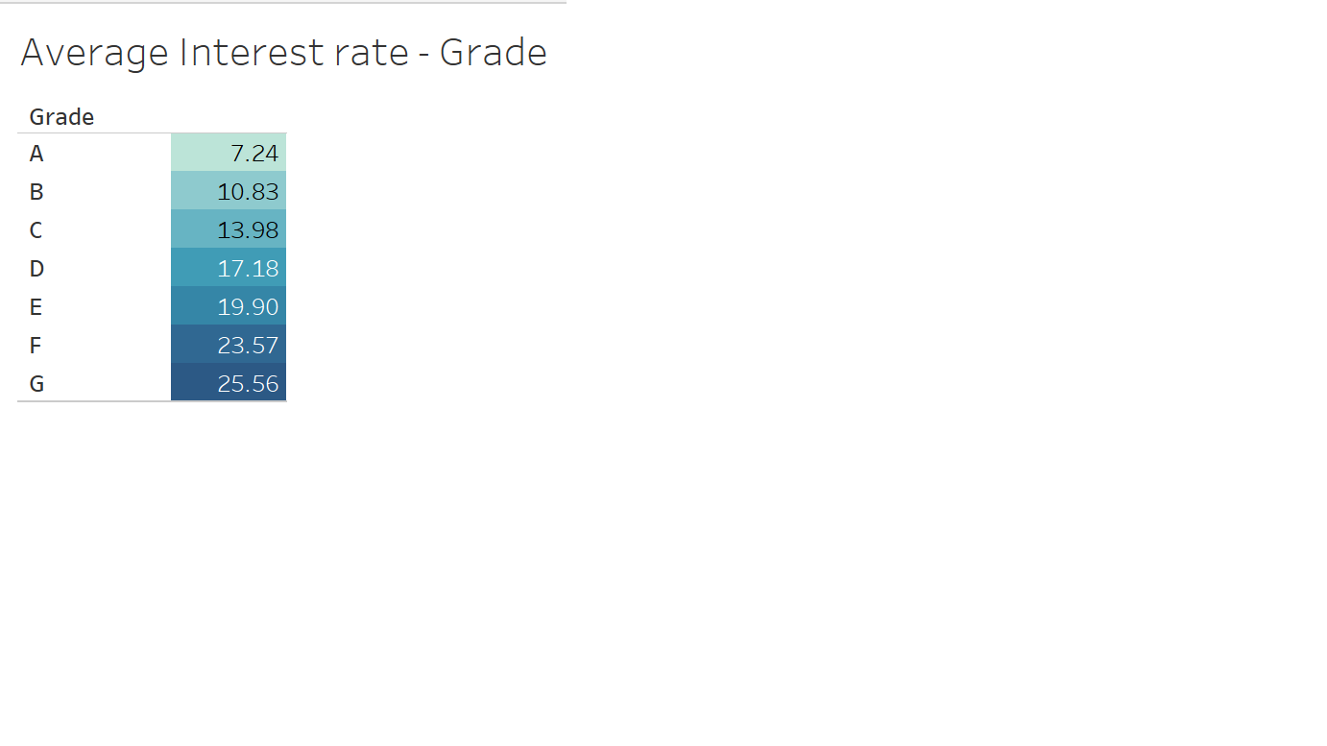
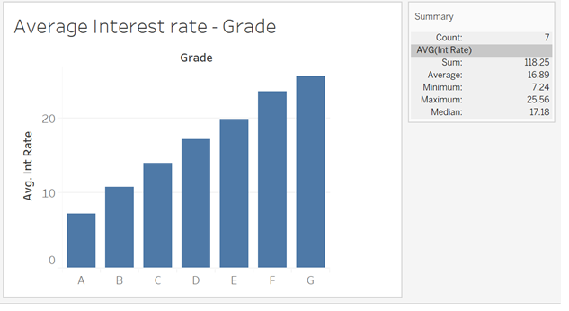
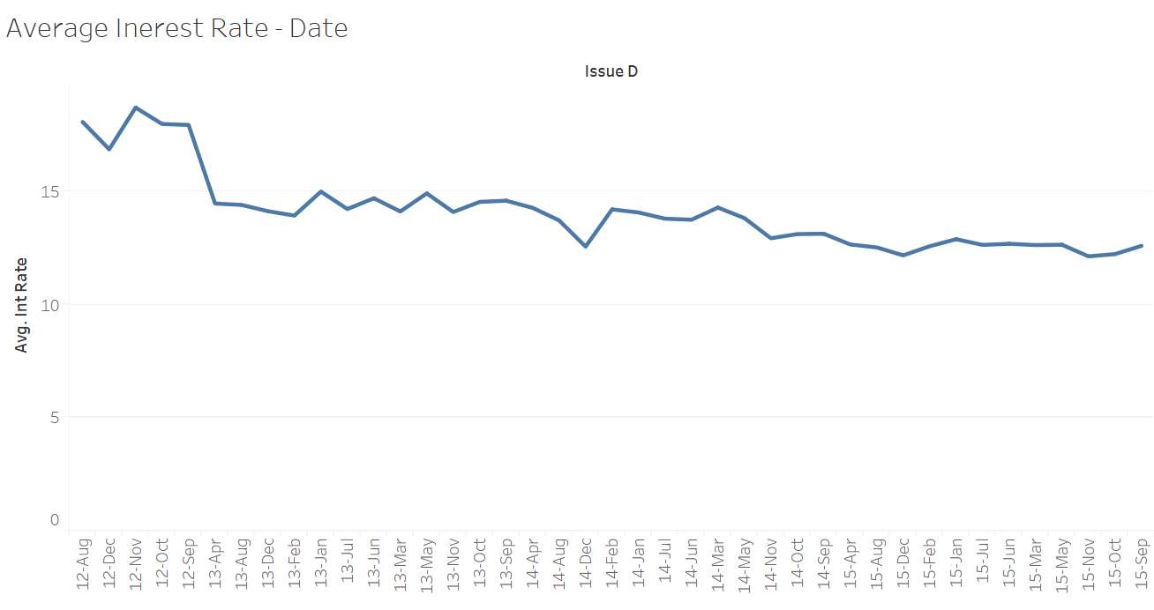
Data Visualization using Tableau
Introduction
Dataset Overview
Objective
Data Cleaning
Data Modeling
Conclusion

Slide 7
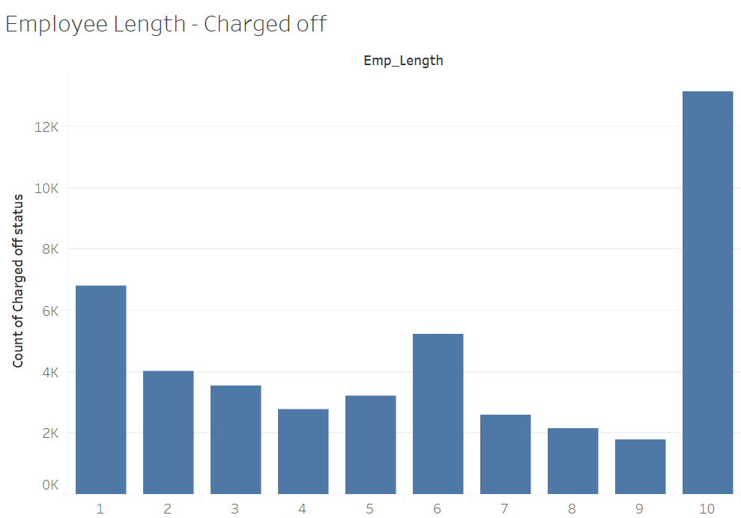
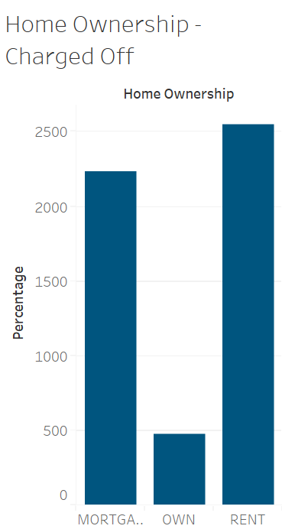
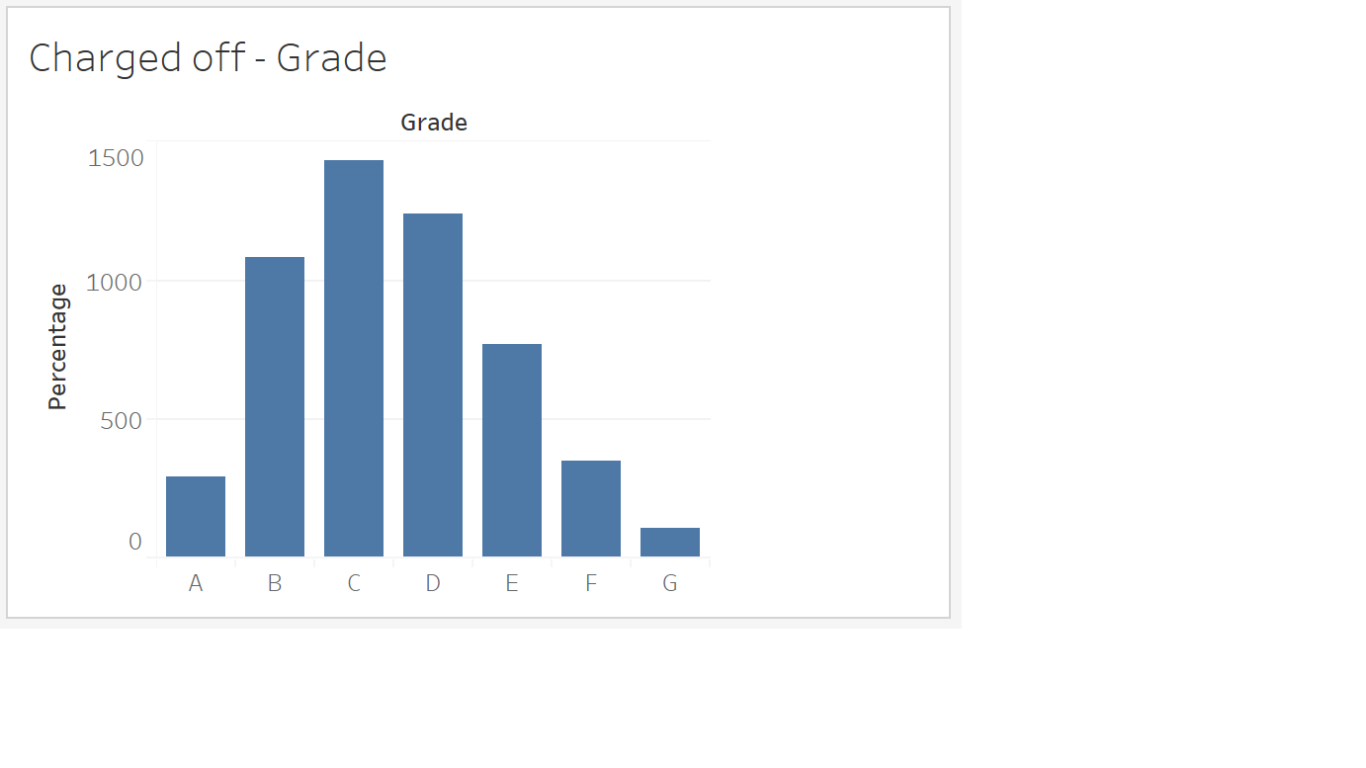
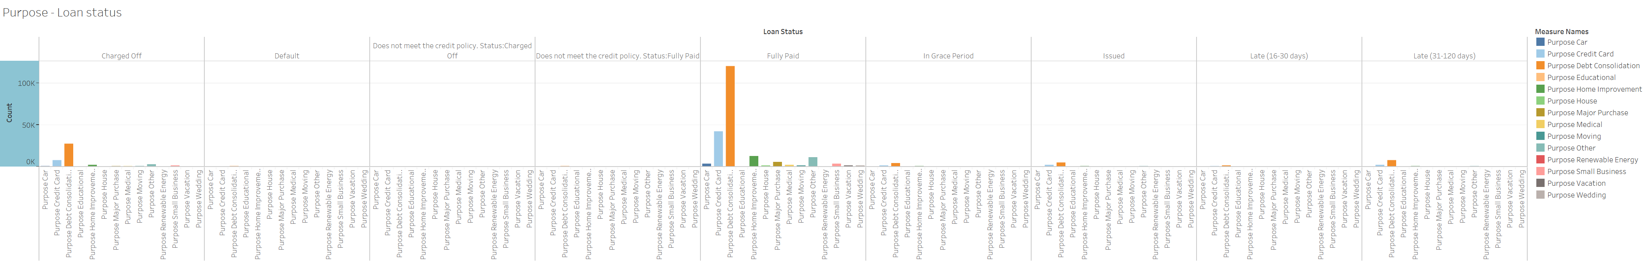
Data Visualization using Tableau
Introduction
Dataset Overview
Objective
Data Cleaning
Data Modeling
Conclusion

Slide 8
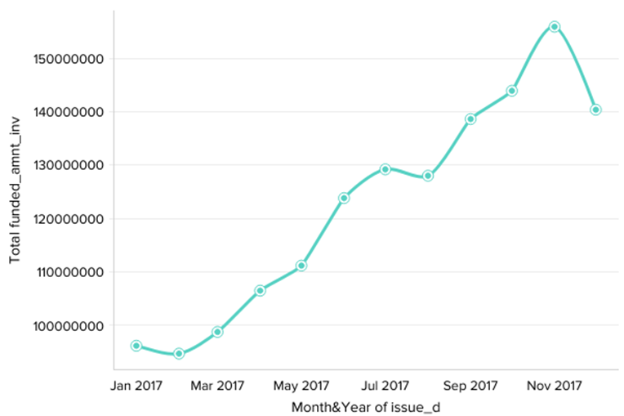
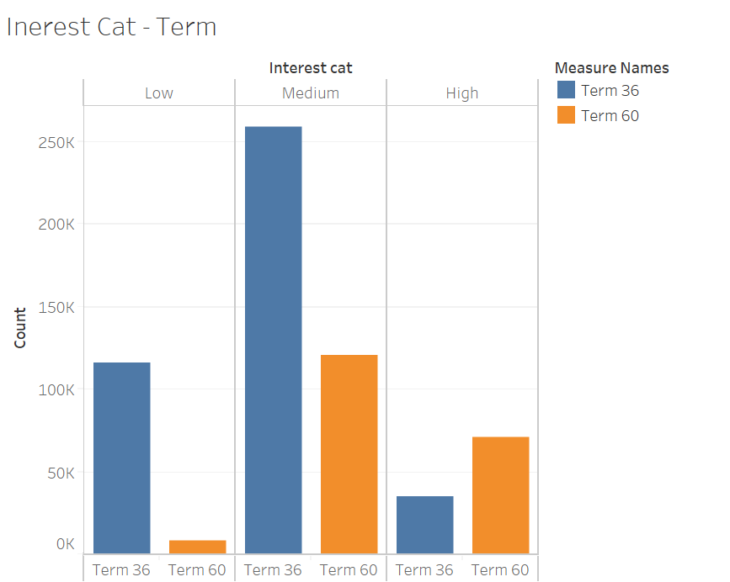
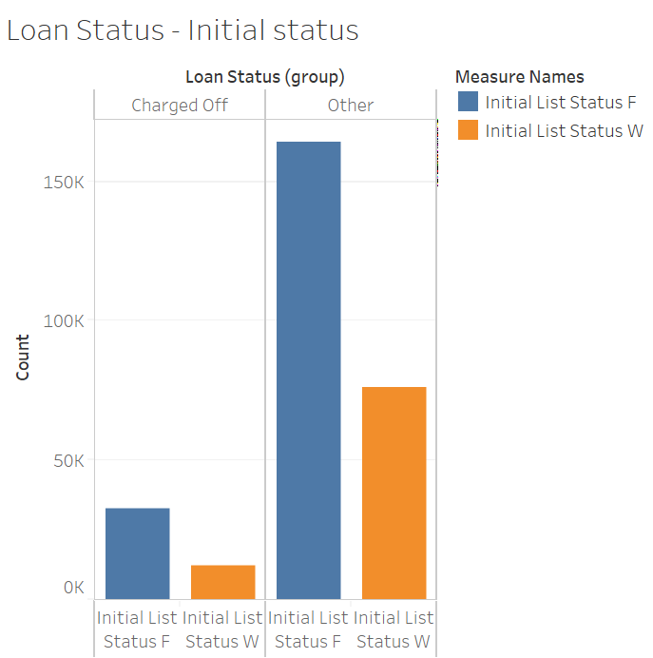
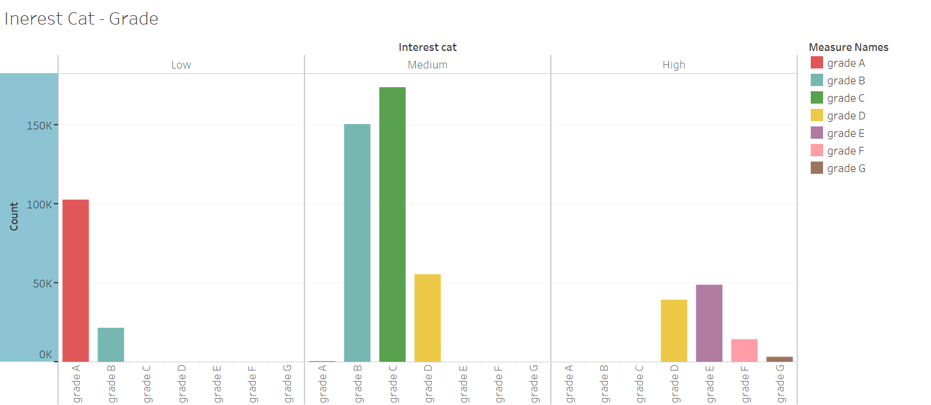
Data Visualization using Tableau
Introduction
Dataset Overview
Objective
Data Cleaning
Data Modeling
Conclusion

Slide 9
Objective
Introduction
Dataset Overview
Objective
Data Cleaning
Data Modeling
Conclusion
Design and develop a model for the predicting whether a prospective borrower would “charge-off”.
Predicting whether a borrower will fall in the low, medium , high interest rate range.
Predicting whether a borrower would receive the complete applied loan amount from the investor.
Derive insights from the lending club loan data to reduce the risk of bad loans

Slide 10
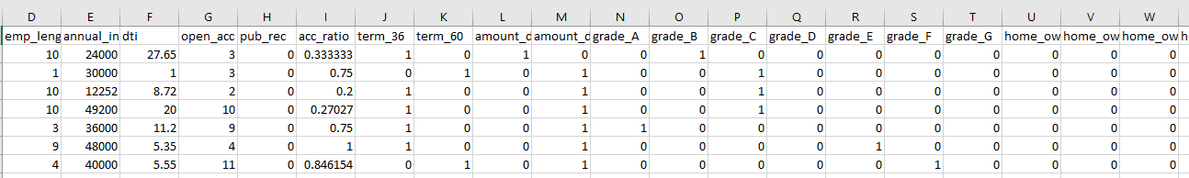
Data Cleaning & Pre-Processing
Introduction
Dataset Overview
Objective
Data Cleaning
Data Modeling
Conclusion
Dataset consisted of 75 variables which we trimmed down to 41 variables by creating other indicator variables
Transformed categorical variables to binary using One Hot Encoding Technique.
Removed redundant variables and columns with little information using Python & Excel.

Slide 11
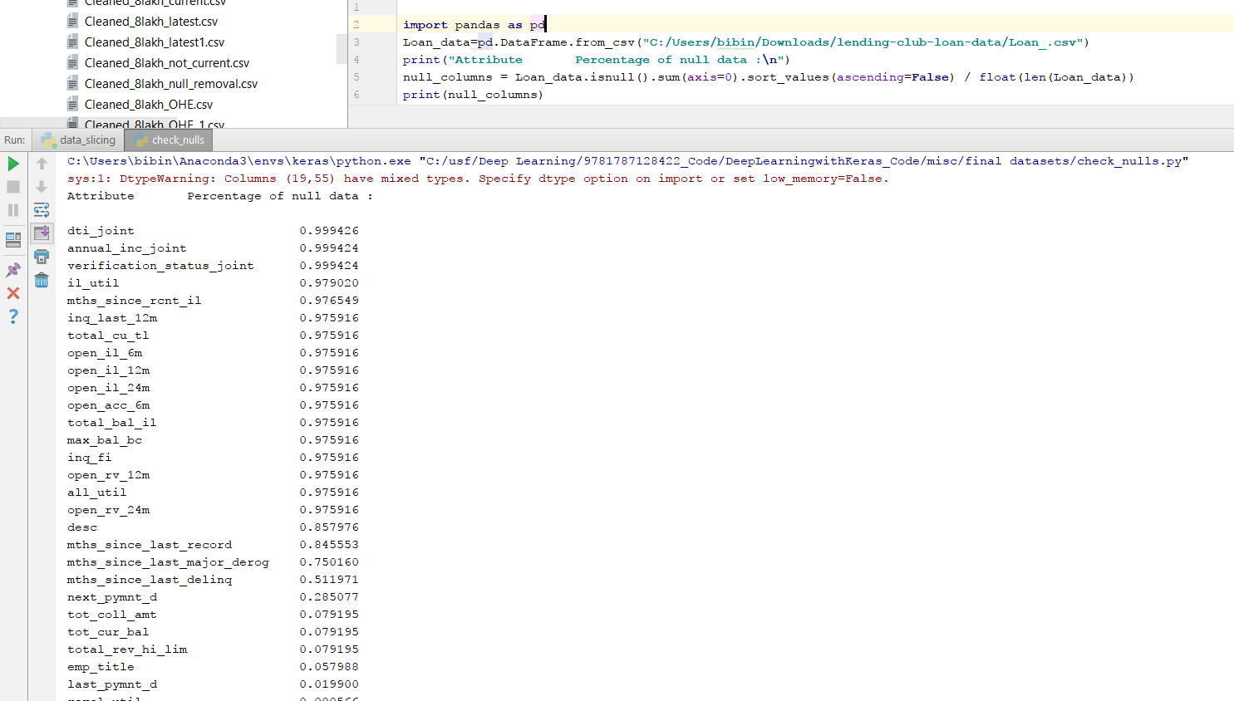
Data Cleaning & Pre-Processing
Introduction
Dataset Overview
Objective
Data Cleaning
Data Modeling
Conclusion
Removed columns with more than 60% null values using python.

Slide 12
Data Cleaning & Pre-Processing
Introduction
Dataset Overview
Objective
Data Cleaning
Data Modeling
Conclusion
Dropped payment_plan ,url ,id and member_id as all are unique.
Removed “Index” Column as it is a Unique customer key .
Removed policy_code,As it has only one value.
Dropped Emp_title , zip_code,title are not useful for Analysis.
Stripped “months” word from term variable and made it an integer
Removed % from interest rate.
Extracted numbers from emp_length and filled the missing values with the median
Transform datetimes(MM_DD_YYY) to a Period using python(MM-YYYY).

Slide 13
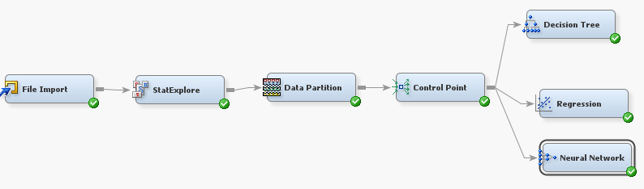
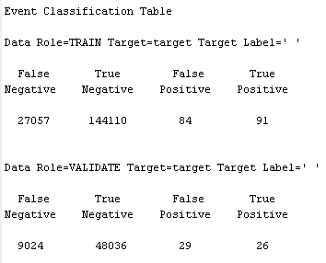
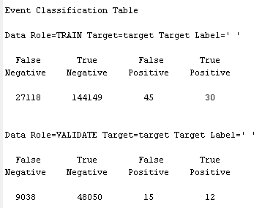
Data Modeling-1
Introduction
Dataset Overview
Objective
Data Cleaning
Data Modeling
Conclusion
Predicting whether a borrower would “charge-off”.

Slide 14
Inference
Introduction
Dataset Overview
Objective
Data Cleaning
Data Modeling
Conclusion
‘Logistic Regression’ and ‘Neural Net’ models were used for predictive modeling.
The misclassification rate is approximately 16% for logistic regression and Neural Network.
The overall accuracy of the model is high, but since we are interested in predicting the charged-off customers ,the ‘True Positive Rate’ is very low.
Our inference from the result is that the charged-off customer cannot be predicted.

Slide 15
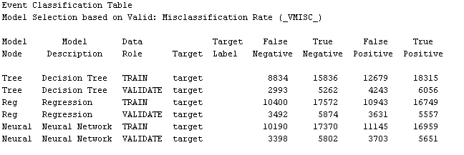
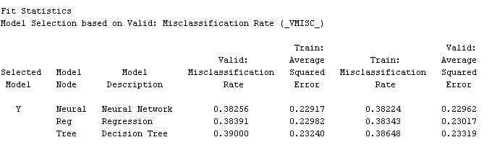
Enhancement-Model1
Introduction
Dataset Overview
Objective
Data Cleaning
Data Modeling
Conclusion
In order to improve the accuracy we performed the over-sampling of data with respect to the charge-off records.
This method of sampling provided us with an improved accuracy of 66.9% for decision tree, 62.4 for Neural Net and 61.1% for Regression.

Slide 16
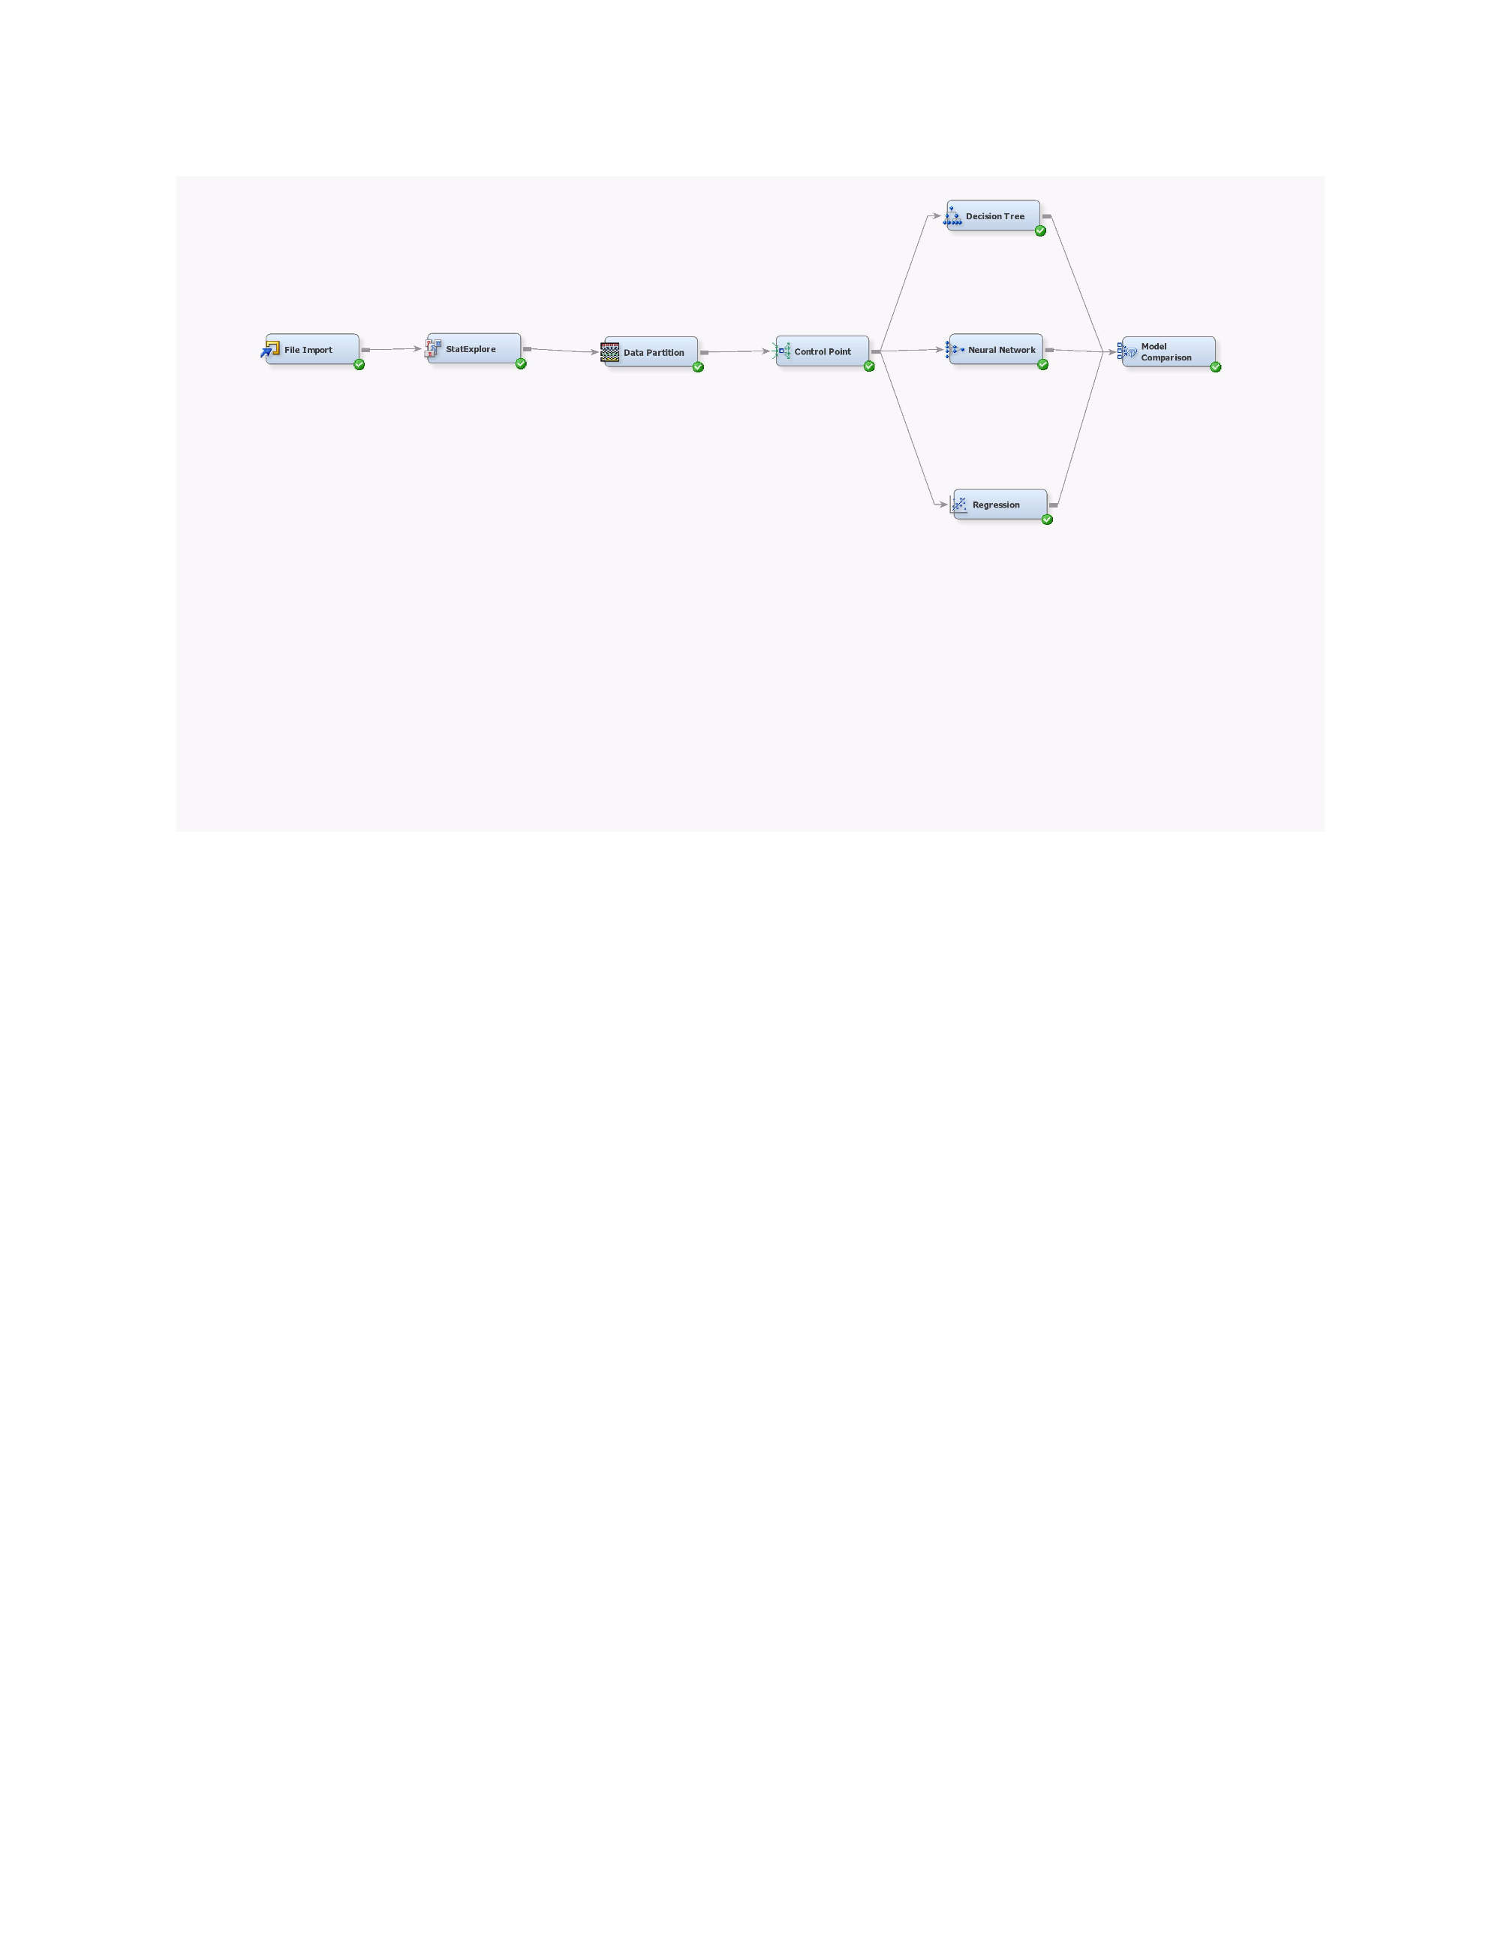
Data Modelling-2
Introduction
Dataset Overview
Objective
Data Cleaning
Data Modeling
Conclusion
Predicting whether a borrower will fall in the low, medium , high interest rate range.
We created the ordinal target variable ‘interest rate range’ into 3 levels of low, medium, high by analyzing the interest rate trend.

Slide 17
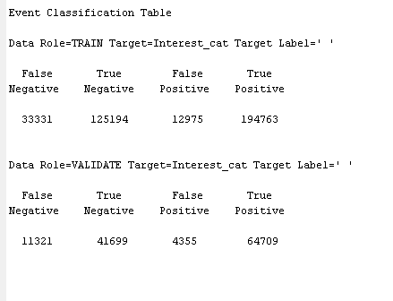
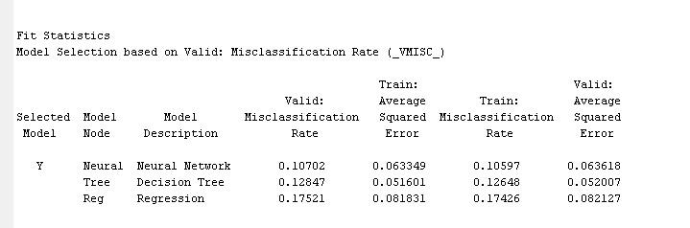
Inference
Introduction
Dataset Overview
Objective
Data Cleaning
Data Modeling
Conclusion
Models used were Logistics Regression, Decision Tree & Neural Net.
The misclassification rate for Decision Tree is 12%. The overall accuracy of the model is too high.
Our inference is that the model works very well for predicting the interest rate group of the prospective borrower.

Slide 18
Data Modeling - 3
Introduction
Dataset Overview
Objective
Data Cleaning
Data Modeling
Conclusion
Predicting whether a borrower would receive the complete applied loan amount from the investor.
Created the binary target variable amount_difference which is a difference of amount applied and amount allotted.

Slide 19
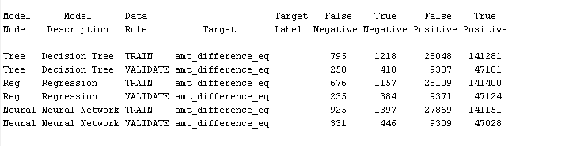
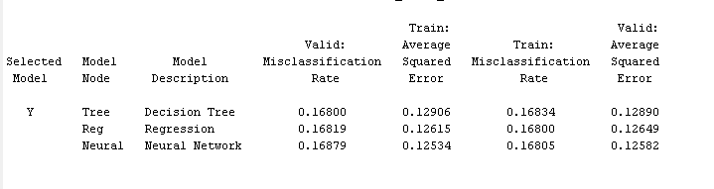
Inference
Introduction
Dataset Overview
Objective
Data Cleaning
Data Modeling
Conclusion
Models used were Logistics Regression, Decision Tree & Neural Net.
The misclassification rate for Decision Tree is 12%. The overall accuracy of the model is too high.
Our inference is that the model works very well for predicting the interest rate group of the prospective borrower.

Slide 20
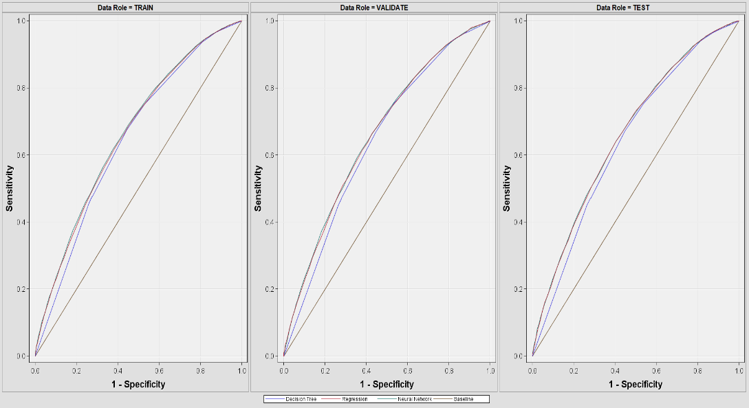
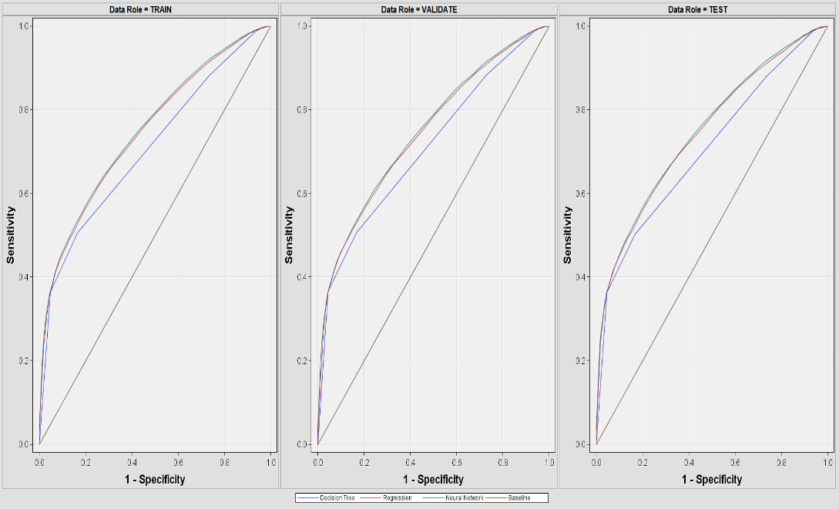
Output
Introduction
Dataset Overview
Objective
Data Cleaning
Data Modeling
Conclusion
Charged-off Model
Amount_difference

Slide 21
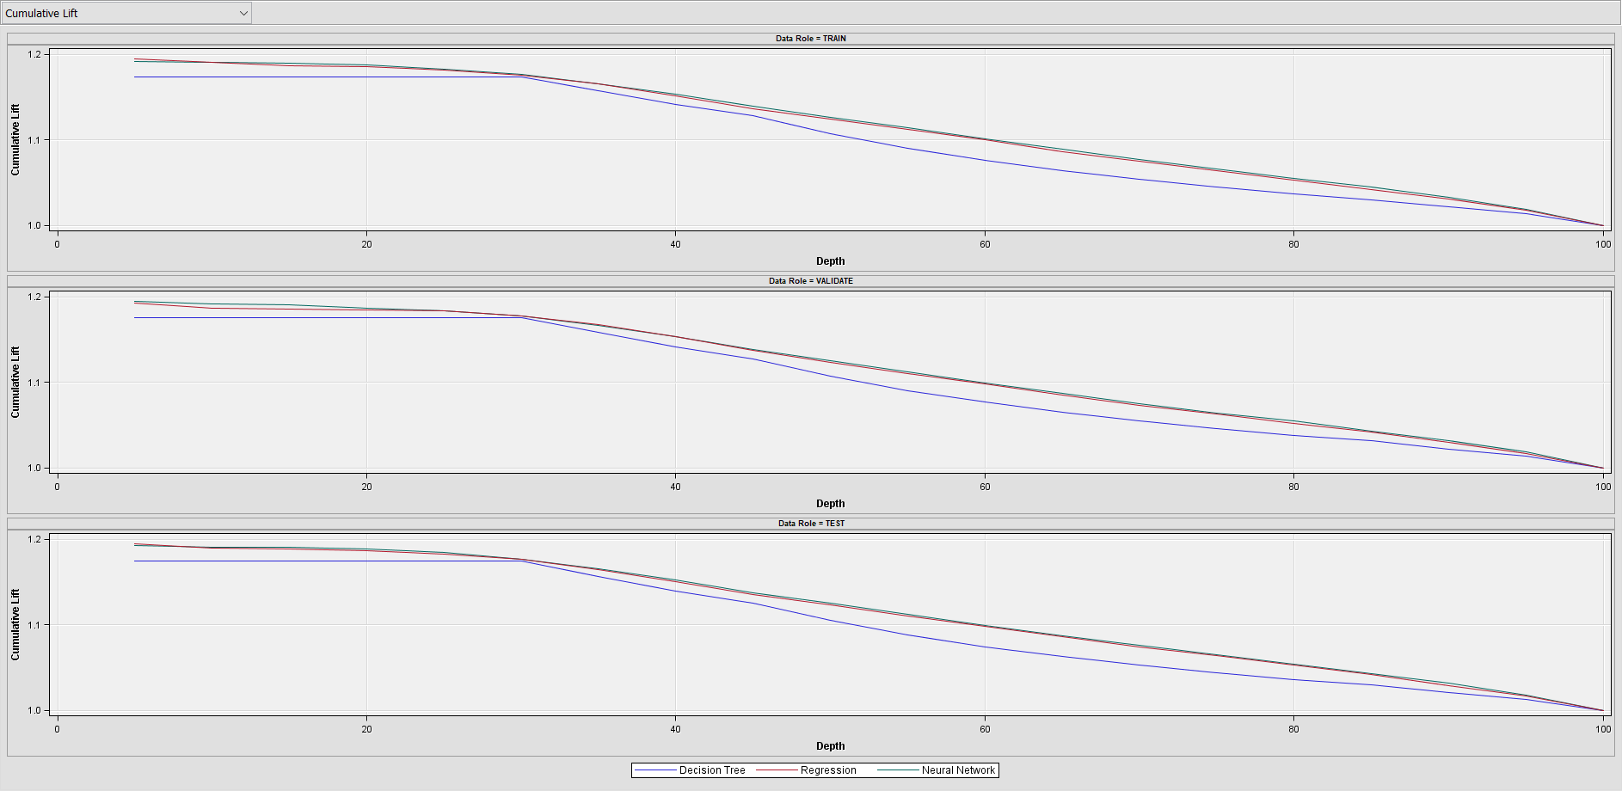
Output
Introduction
Dataset Overview
Objective
Data Cleaning
Data Modeling
Conclusion
Cumulative Lift Curve

Slide 22
Future Enhancement
Introduction
Dataset Overview
Objective
Data Cleaning
Data Modeling
Conclusion
Statistical techniques such as Principal component analysis, support vector machines could be used on the data, before running the model to improve the accuracy.
Title(Loan title provided by the borrower) and description columns could be used for NLP techniques and also sentiment analysis.
Synthetic Minority Over-sampling Technique is a technique to create synthetic data ,to build better models and predictions.
The models can be provided as an API service to customers and investors ,so that they can build dashboards with output prediction.

Slide 23
References
Introduction
Dataset Overview
Objective
Data Cleaning
Data Modeling
Conclusion
Data Source: https://www.lendingclub.com/info/download-data.action
https://en.wikipedia.org/wiki/Lending_Club
https://www.kaggle.com/wendykan/lending-club-loan-data

Slide 24

Thoughts & Suggestions…!!!
Introduction
Dataset Overview
Objective
Data Cleaning
Data Modeling
Conclusion

